Slide 1
ЯECERT
Expediting recertification's and clearances

Slide 2




TARGET USERS:
EMPLOYERS/ EMPLOYEES THAT REQUIRES CERTIFICATIONS
FEDERAL GOVERNMENT/EMPLOYEES (i.e.: DOD, DOE, DOA, HLS, etc.)

Slide 3
CURRENT ISSUE:
REQUIREMENTS FOR CERTIFICATIONS/ RECERTIFICATIONS
DEADLINES AND PROCESS LENGTH
BASIC UNDERSTANDING OF THE PROCESS

Slide 4
APPLICATION :
1. GIVES THE USER THE NECESSARY RESOURCES TO AQUIRE THE CERT/CLEARANCE
2. ALERTS THE COMMAND/EMPLOYER WHO & WHEN NEEDS TO TURN IN DOCMENTS AND UPDATES ON WHO’S ACTION IS REQUIRED. ( 180, 90, 60, 30-0)
ALLOWS MEMBER TO CHECK INDIVIDUAL STATUS/PROGRESSION

Slide 5
HOW :
USING TOP LEVEL ENCRYTION
LOCAL ADMINISTRATORS
PROFILE DATABASES
SEARCH ENGINE

Slide 6
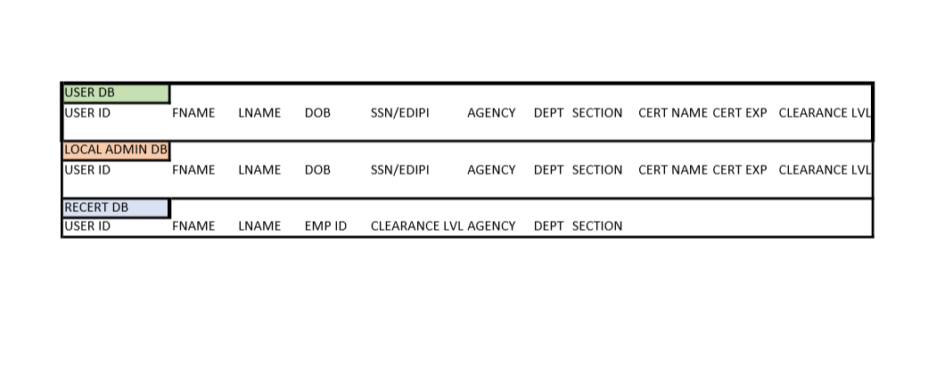
LOCAL DATABASE LAYOUTS
The user DB will have access to most of the application but limited to his/her account
Local Admin accounts will have user access based on entities that they belong to.
Recert DB will have access to both local and user accounts but limiting based on security levels employees are given

Slide 7
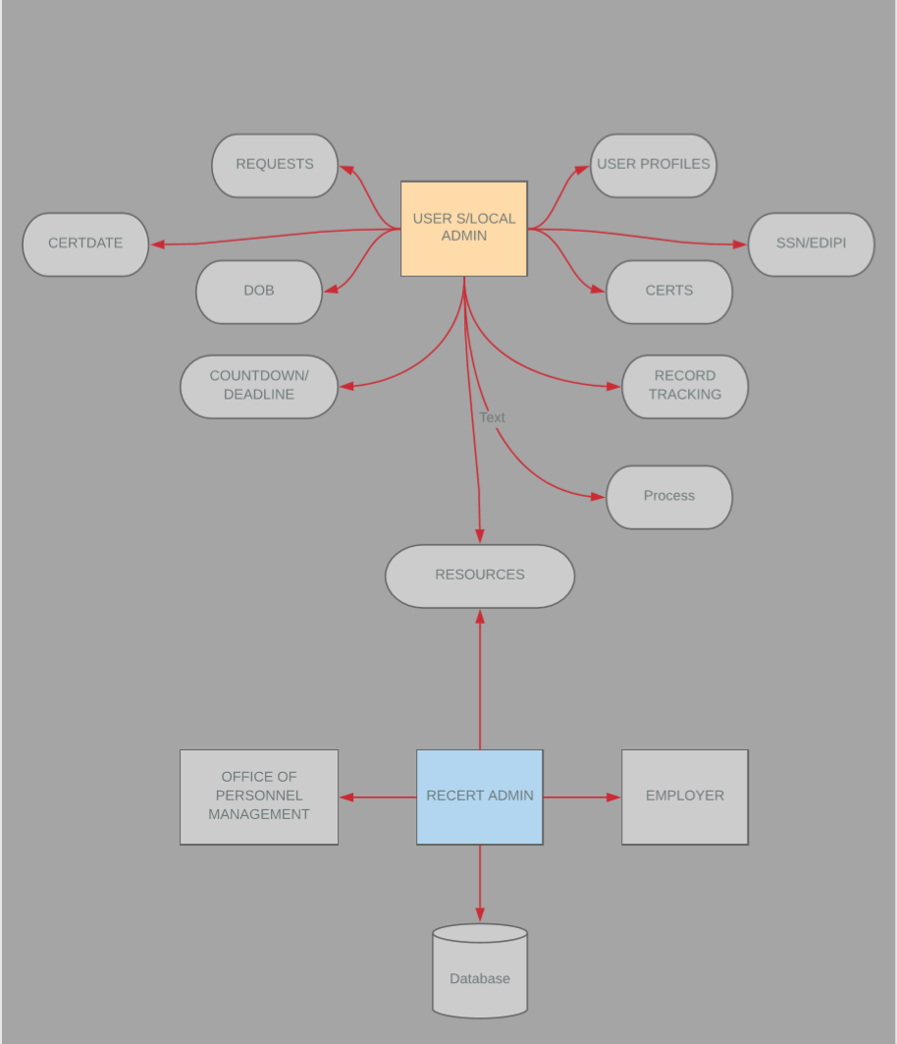
Entity Relationship diagram:

Slide 8
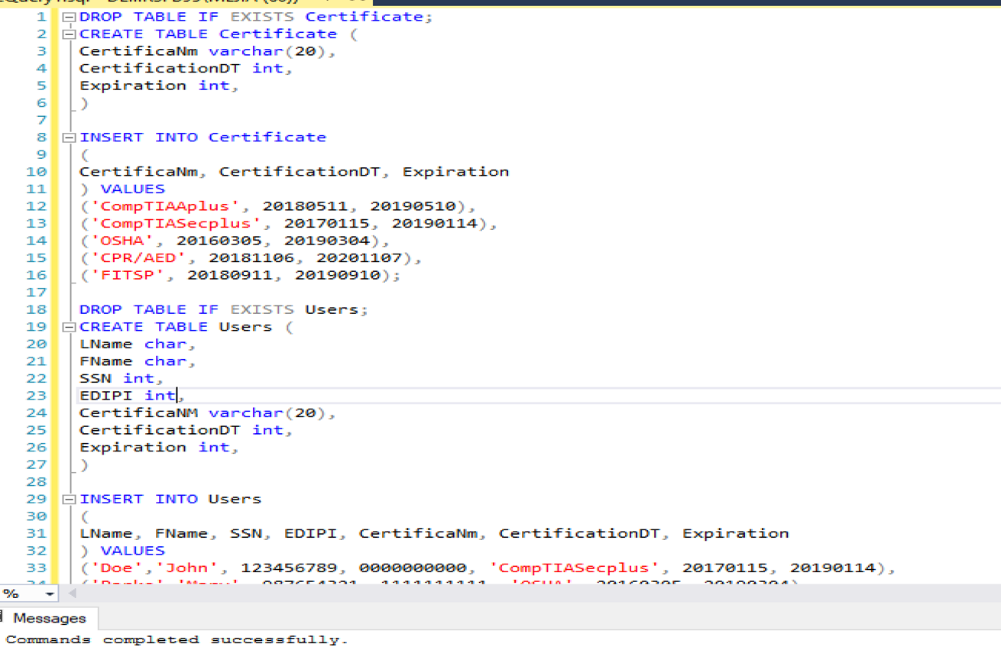
DATABASE TABLES :
Tables reflects basic certifications, the date received and the expiration dates.
The users that have the certifications, their SSN/EDIPI, certification, dates and when they expire.

Slide 9
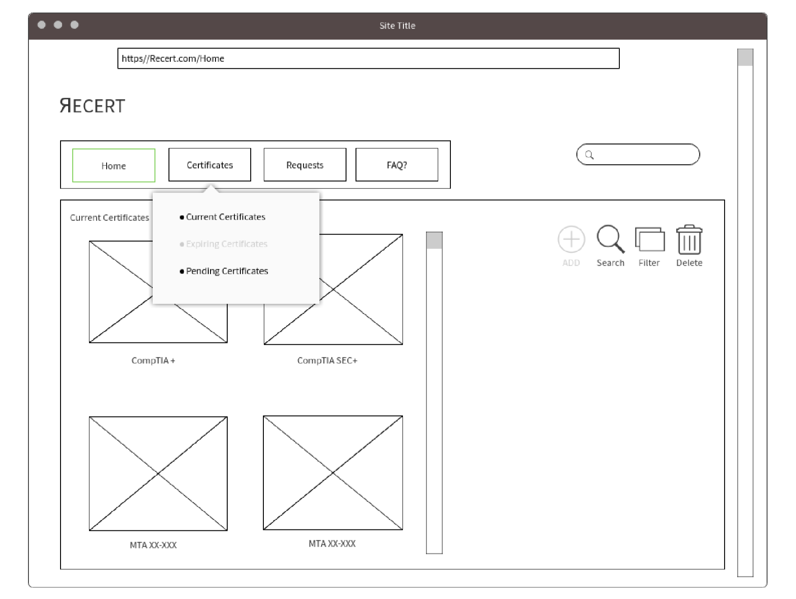
WIREFRAME SAMPLE
The User will be able to navigate through the site with ease.
Search Feature
Easily upload, Delete and Update current Certifications
User will be able to Request resources and information on future certifications

Slide 10
GitHub
https://github.com/jobmejia

Slide 11
?QUESTIONS?
???

